Slide 1
Virtualization and Cloud Computing
Data center hardware
David Bednárek, Jakub Yaghob, Filip Zavoral

Slide 2
Resources
Books
H. Geng: Data Center Handbook, ISBN: 978-1118436639, Willey, 2014
B.A. Ayomaya: Data Center for Beginners: A beginner's guide towards understanding Data Center Design, ASIN: B01NC24WNL, Amazon, 2017

Slide 3
Motivation for data centers
Standardization/consolidation
Reduce the number of DCs of an organization
Reduce the number of HW, SW platforms
Standardized computing, networking and management platforms
Virtualization
Consolidate multiple DC equipment
Lower capital and operational expenses
Automating
Automating tasks for provisioning, configuration, patching, release management, compliance
Securing
Physical, network, data, user security

Slide 4
Data center requirements
Business continuity
Availability
ANSI/TIA-942 standard
Tier 1
Single non-redundant distribution path
Non-redundant capacity with availability 99.671% (1729 min/year)
Tier 2
Redundant capacity with availability 99.741% (1361 min/year)
Tier 3
Multiple independent distribution paths
All IT components dual-powered
Concurrently maintainable site infrastructure with availability 99.982% (95 min/year)
Tier 4
All cooling equipment dual-powered
Fault-tolerant site infrastructure with electrical power storage with availability 99.995% (26 min/year)

Slide 5
Problems of data centers – design
Mechanical engineering infrastructure design
Mechanical systems involved in maintaining interior environment
HVAC (heating, ventilation, air conditioning)
Humidification and dehumidification, pressurization
Saving space and costs while maintaining availability
Electrical engineering infrastructure design
Distribution, switching, bypass, UPS
Modular, scalable
Technology infrastructure design
Cabling for data communication, computer management, keyboard/mouse/video
Availability expectations
Higher availability needs bring higher capital and operational costs
Site selection
Availability of power grids, networking services, transportation lines, emergency services
Climatic conditions

Slide 6
Problems of data centers – design
Modularity and flexibility
Grow and change over time
Environmental control
Temperature 16-24 °C, humidity 40-55%
Electrical power
UPS, battery banks, diesel generators
Fully duplicated
Power cabling
Low-voltage cable routing
Cable trays
Fire protection
Active, passive
Smoke detectors, sprinklers, fire suppression gaseous systems
Security
Physical security

Slide 7
Problems of data centers – energy use
Energy efficiency
Power usage effectiveness
State of the art DC have PUE ≈ 1.2
Power and cooling analysis
Power is the largest recurring cost
Hot spots, over-cooled areas
Thermal zone mapping
Positioning of DC equipment

Slide 8
Problems of data centers – other aspects
Network infrastructure
Routers and switches
Two or more upstream service providers
Firewalls, VPN gateways, IDS
DC infrastructure management
RT monitoring, management
Applications
DB, file servers, application servers, backup

Slide 9

Data centers – examples

Slide 10

Data centers – examples

Slide 11
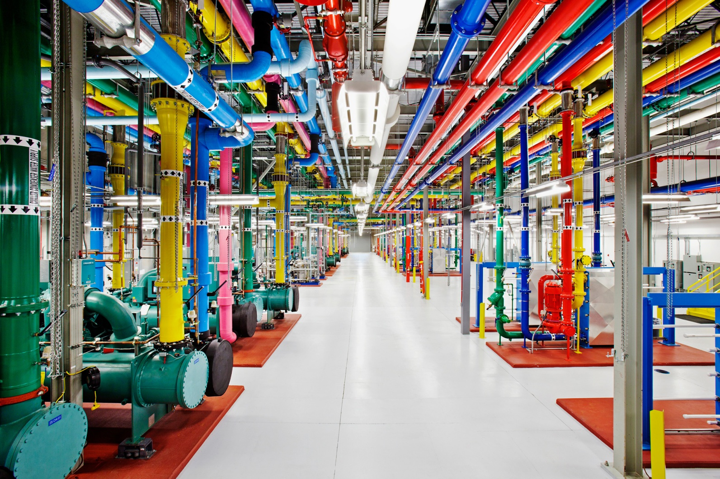
Data centers – examples

Slide 12
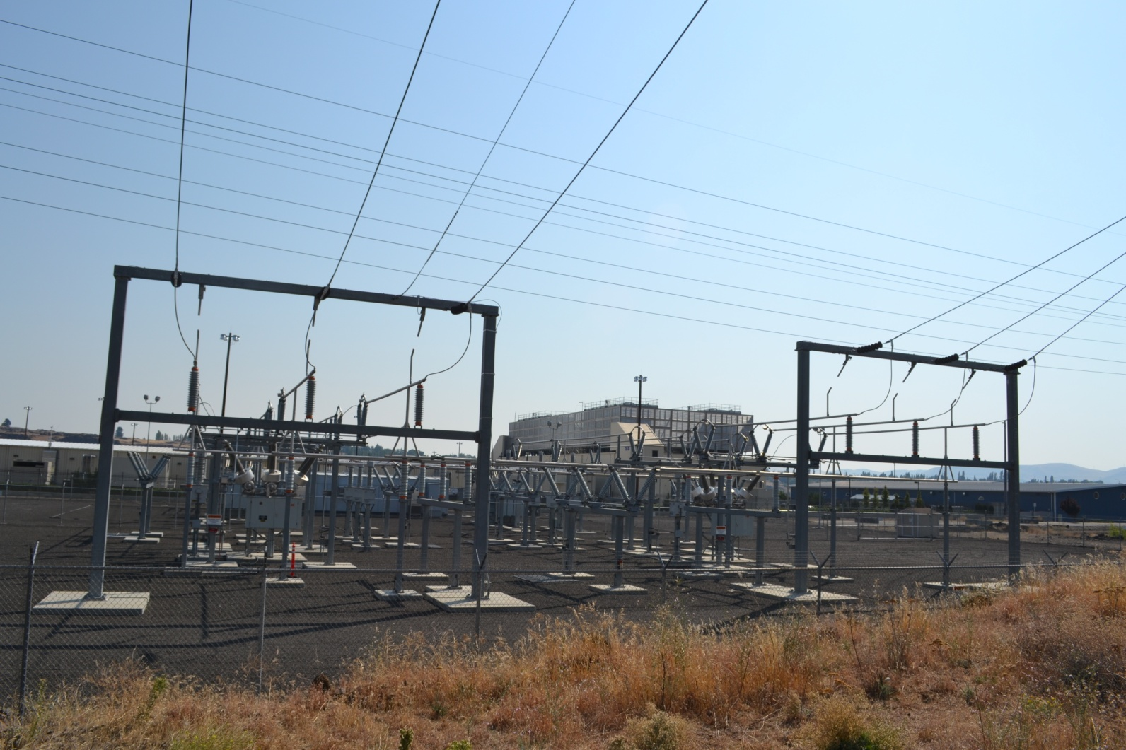
Data centers – examples

Slide 13
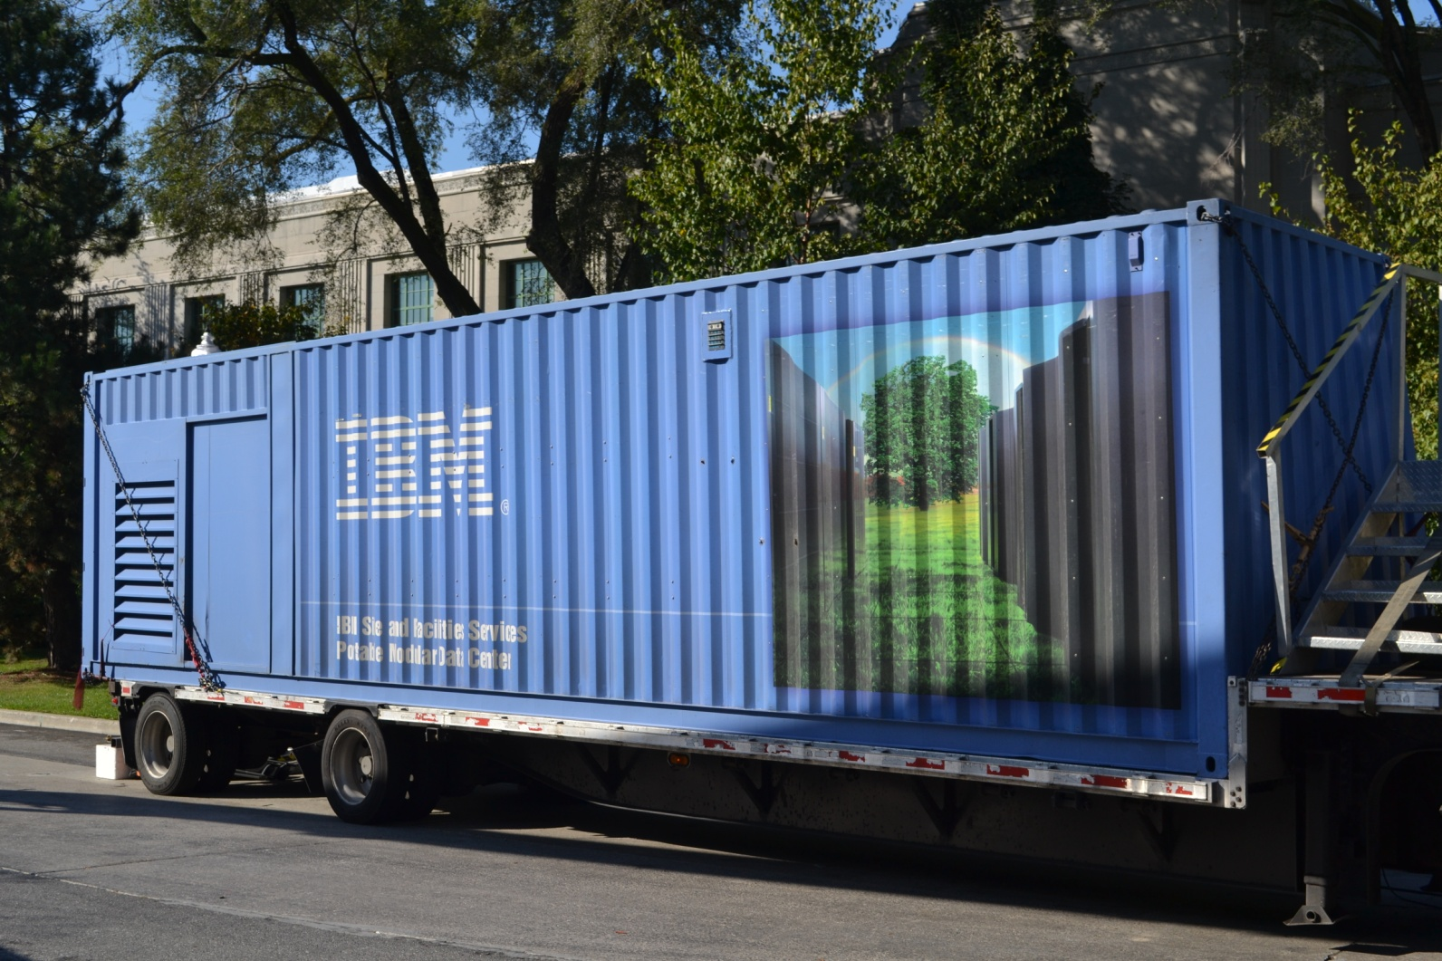
Portable data center

Slide 14
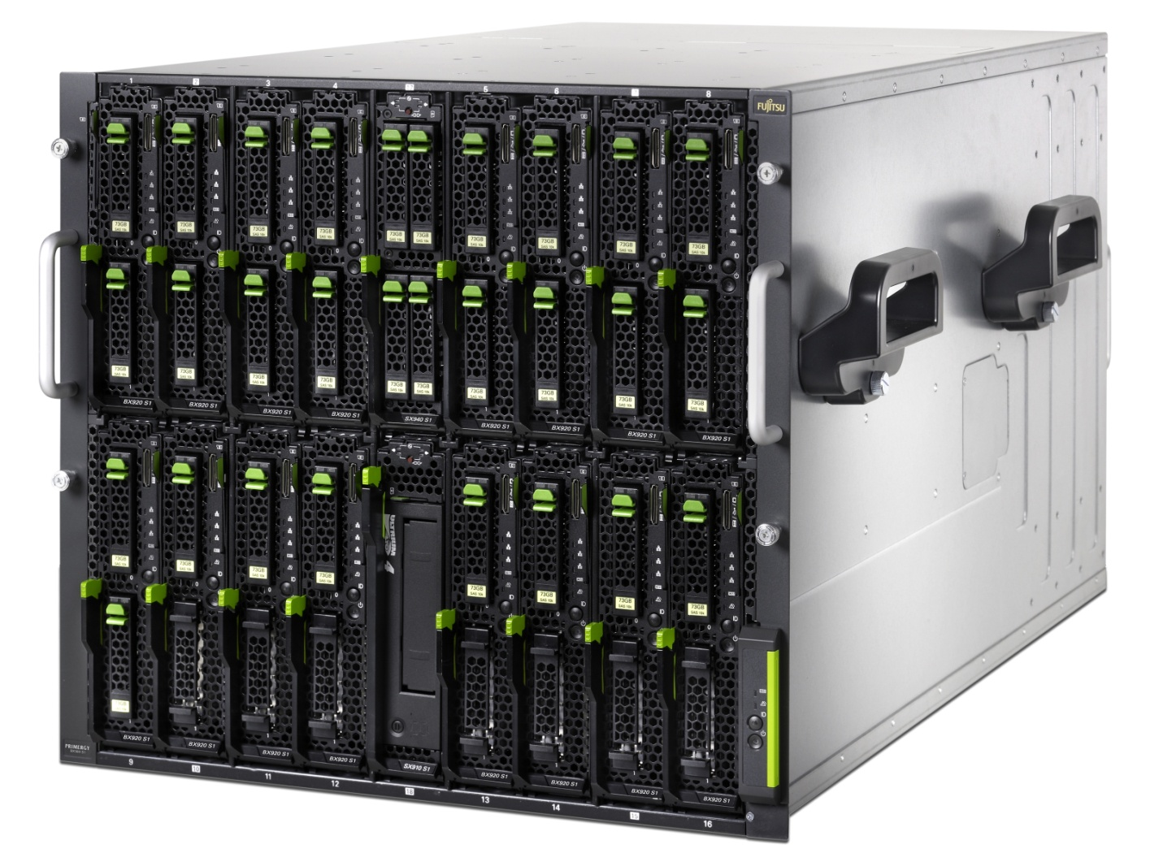
Data centers – blade servers

Slide 15
Blade servers
Modular design optimized to minimize the use of physical space and energy
Chassis
Power, cooling, management
Networking
Mezzanine cards
Switches
Blade
Stripped server
Storage

Slide 16
Storage area network – SAN
Block level data storage over dedicated network
Server 1
Server 2
Switch A
Switch B
Controller a
Controller b
Disk array γ

Slide 17
SAN
Server 1
Server 2
Server n
Switch A
Switch B
Controller a
Controller b
Controller a
Controller b
Controller a
Controller b
Disk array α
Disk array β
Disk array γ

Slide 18
SAN protocols
iSCSI
Mapping SCSI over TCP/IP
Ethernet speeds (1, 10 Gbps)
iSER
iSCSI Extension over RDMA
InfiniBand
FC
Fibre channel
High speed technology for storage networking
FCoE
Encapsulating FC over Ethernet 10

Slide 19
Fibre channel
High speed
4, 8, 16 Gbps
Throughput 800, 1600, 3200 MBps
Security
Zoning
Topologies
Point to point
Arbitrated loop
Switched fabric
Ports
FCID (like MAC)
Type
N – node port
NL – node loop port
F – fabric port
FL – fabric loop port
E – expansion (between two switches)
G – generic (works as E or F)
U – universal (any port)
Host
Storage
N
N
NL
Storage
NL
NL
Host
NL
NL
NL
Storage
Host
Host
N
N
F
F
Switch
Switch
Switch
E
E
F
F
N
N
Storage
Storage

Slide 20
iSCSI
Host
Host
Initiator
Client
HW, SW
Target
Storage resource
LUN
Logical unit number
Security
CHAP
VLAN
LUN masking
Network booting
Initiator α
Initiator β
TCP/IP network
Disk array
Target
α: A=0, B=1
A
B
C
β: B=0, C=1

Slide 21
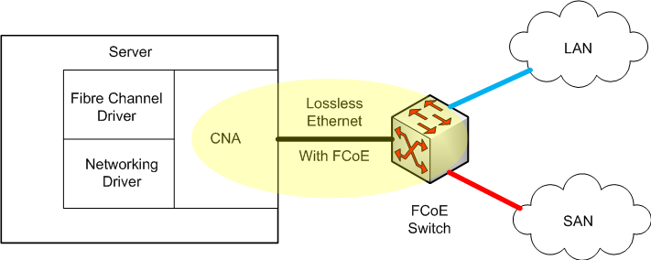
FCoE
Replaces FC0 and FC1 layers of FC
Retaining native FC constructs
Integration with existing FC
Required extensions
Encapsulation of native FC frames into Ethernet frames
Lossless Ethernet
Mapping FCID and MAC
Converged network adapter
FC HBA+NIC
Consolidation
Reduce number of network cards
Reduce number of cables and switches
Reduce power and cooling costs

Slide 22
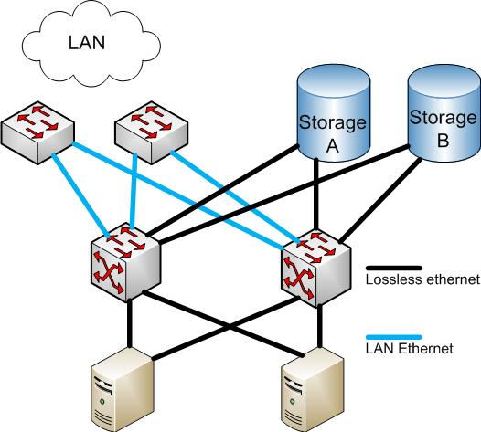
FCoE

Slide 23
Disk arrays
Disk storage system with multiple disk drives
Components
Disk array controllers
Cache
RAM, disk
Disk enclosures
Power supply
Provides
Availability, resiliency, maintainability
Redundancy, hot swap, RAID
Categories
NAS, SAN, hybrid

Slide 24
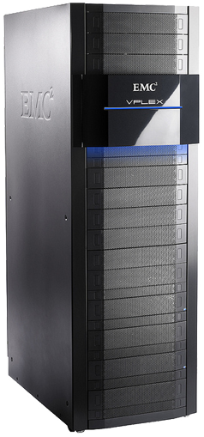
Enterprise disk arrays
Additional features
Automatic failover
Snapshots
Deduplication
Replication
Tiering
Front end, back end
Virtual volume
Spare disks
Provisioning

Slide 25
RAID levels
Redundant array of independent disks
Originally redundant array of inexpensive disks
Why?
Availability
MTBF (Mean Time Between Failure)
Nowadays ≈400 000 hours for consumer disks, ≈1 400 000 hours for enterprise disks
MTTR (Mean Time To Repair)
Performance
Other issues
Using disks with the same size

Slide 26
RAID – JBOD
Just Bunch Of Disks
Minimum of drives: 1
Space efficiency: 1
Fault tolerance: 0
Array failure rate: 1-(1-r)^{n}
Read benefit: 1
Write benefit: 1

Slide 27
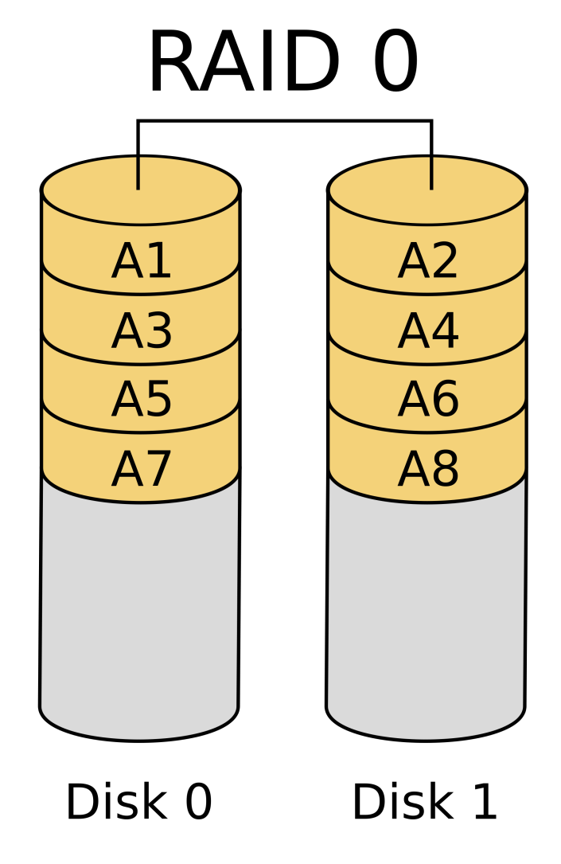
RAID – RAID0
Striping
Minimum of drives: 2
Space efficiency: 1
Fault tolerance: 0
Array failure rate: 1-(1-r)^{n}
Read benefit: n
Write benefit: n

Slide 28
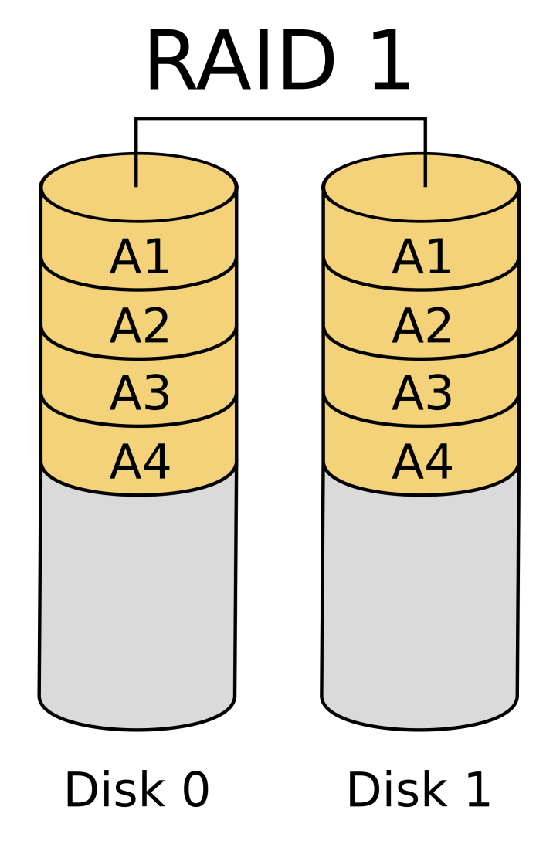
RAID – RAID1
Mirroring
Minimum of drives: 2
Space efficiency: 1/n
Fault tolerance: n-1
Array failure rate: r^{n}
Read benefit: n
Write benefit: 1

Slide 29
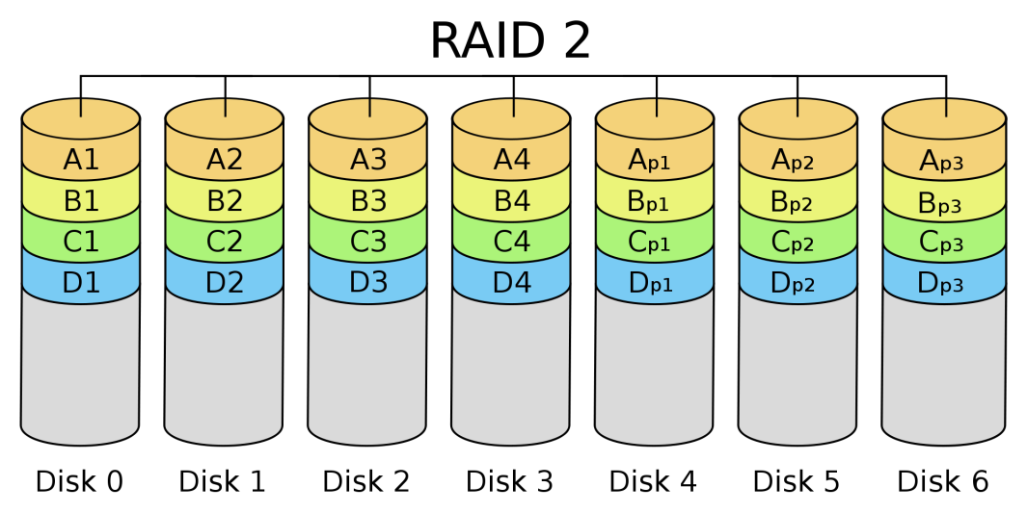
RAID – RAID2
Bit striping with dedicated Hamming code parity
Minimum of drives: 3
Space efficiency: 1-1/n . log₂(n-1)
Fault tolerance: 1
Array failure rate: variable
Read benefit: variable
Write benefit: variable

Slide 30
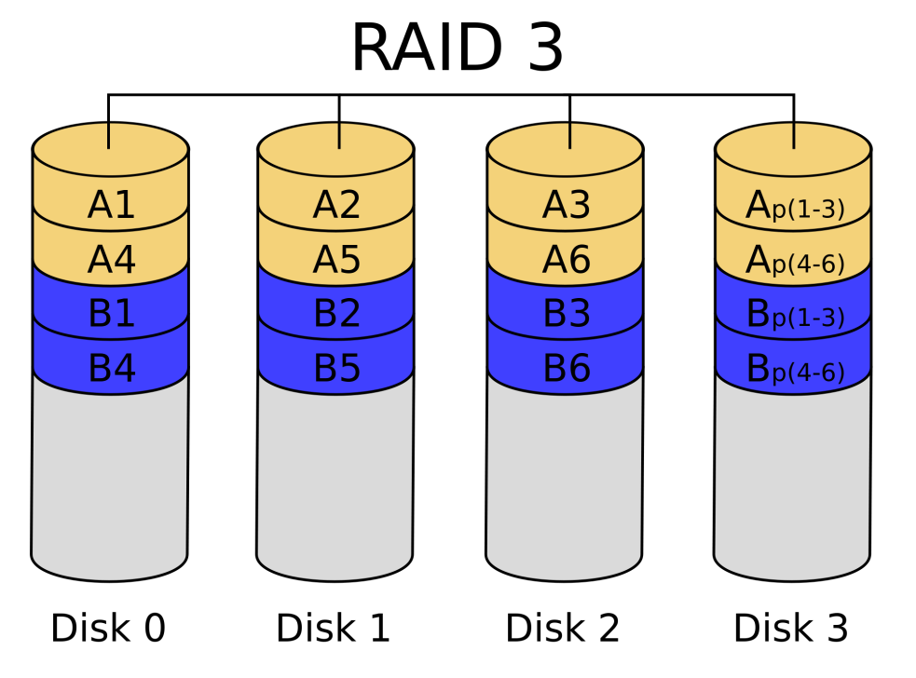
RAID – RAID3
Byte striping with dedicated parity
Minimum of drives: 3
Space efficiency: 1-1/n
Fault tolerance: 1
Array failure rate: n(n-1)r²
Read benefit: n-1
Write benefit: n-1

Slide 31
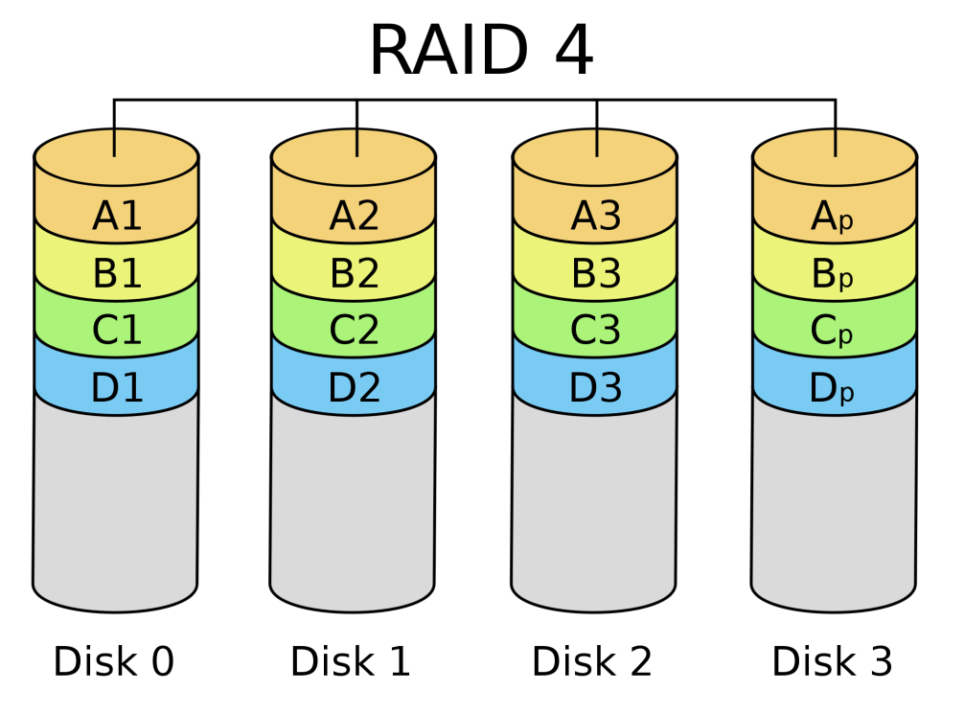
RAID – RAID4
Block striping with dedicated parity
Minimum of drives: 3
Space efficiency: 1-1/n
Fault tolerance: 1
Array failure rate: n(n-1)r²
Read benefit: n-1
Write benefit: n-1

Slide 32
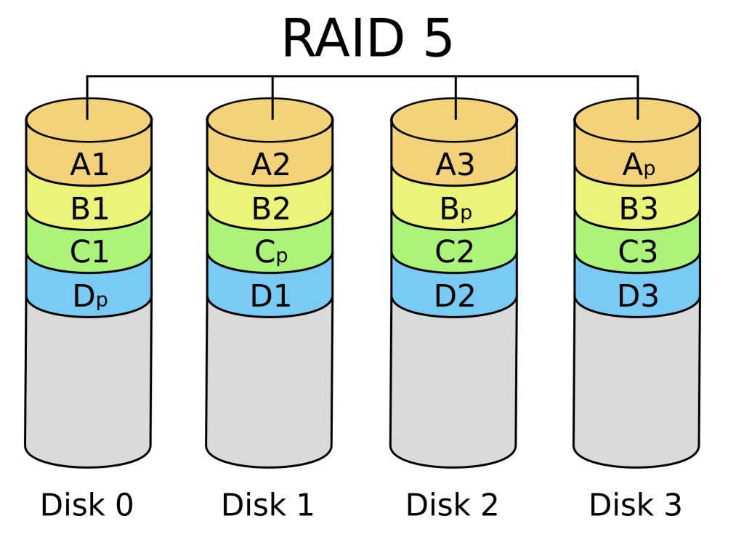
RAID – RAID5
Block striping with distributed parity
Minimum of drives: 3
Space efficiency: 1-1/n
Fault tolerance: 1
Array failure rate: n(n-1)r²
Read benefit: n-1
Write benefit: n-1

Slide 33
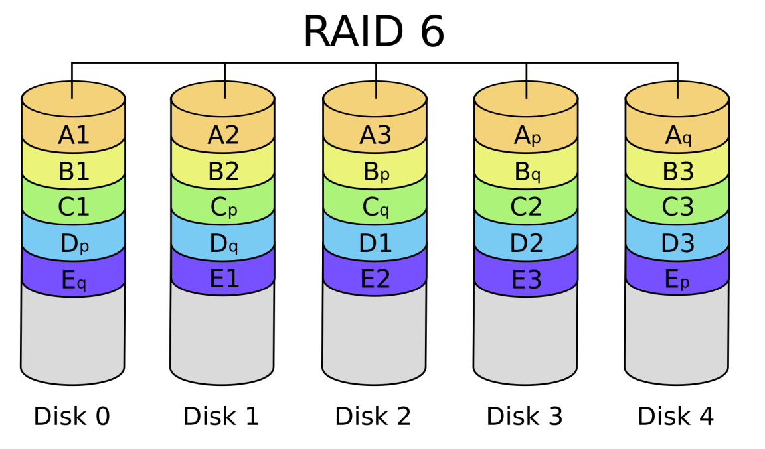
RAID – RAID6
Block striping with double distributed parity
Minimum of drives: 4
Space efficiency: 1-2/n
Fault tolerance: 2
Array failure rate: n(n-1)(n-2)r³
Read benefit: n-2
Write benefit: n-2

Slide 34
RAID – nested (hybrid) RAID
RAID 0+1
Striped sets in mirrored set
Min drives: 4, even number of drives
RAID 1+0 (RAID 10)
Mirrored sets in a striped set
Min drives: 4, even number of drives
Fault tolerance: each mirror can loose a disk
RAID 5+0 (RAID50)
Block striping with distributed parity in a striped set
Min drives: 6
Fault tolerance: one disk in each RAID5 block

Slide 35
Tiering
Different tiers with different price, size, performance
Tier 0
Ultra high performance
DRAM or flash
$20-50/GB
1M+ IOPS
<500 μs latency
Tier 1
High performance enterprise app
15k + 10k SAS
$5-10/GB
100k+ IOPS
<1 ms latency
Tier 2
Mid-market storage
SATA
<$3/GB
10K+ IOPS
<10 ms latency

